Slide 1
Digital Portfolio
STUDENT NAME: SADHANA C
REGISTER NO AND NMID: 2426J1556/0FBACA1EE58A53CB8214A374E0467341
DEPARTMENT: BSC INFORMATION TECHNOLOGY
COLLEGE: KPR COLLEGE OF ARTS SCIENCE AND RESEARCH/BHARATHIAR UNIVERSITY

Slide 2
PROJECT TITLE
Learning Portfolio

Slide 3


AGENDA
Problem Statement
Project Overview
End Users
Tools and Technologies
Portfolio design and Layout
Features and Functionality
Results and Screenshots
Conclusion
Github Link
3/21/2024 Annual Review

Slide 4

PROBLEM STATEMENT
Students often complete assignments and projects, but their learning progress is scattered.
There is no single platform to showcase growth, skills, and achievements.
A digital learning portfolio solves this by collecting evidence of learning in one place.

Slide 5

PROJECT OVERVIEW
A Learning Portfolio is a structured collection of learning experiences.
It documents what was learned, how it was learned, and reflections.
The project demonstrates personal growth in both knowledge and skills.

Slide 6

WHO ARE THE END USERS?
Students – to track learning and present achievements.
Teachers – to evaluate student progress more effectively.
Recruiters/Employers – to see skills and practical work of students.

Slide 7

TOOLS AND TECHNIQUES
Website builder / PowerPoint / Canva (for design).
GitHub (for project hosting, if coding included).
Simple coding (HTML, CSS) or documentation tools.

Slide 8
POTFOLIO DESIGN AND LAYOUT
Sections: Introduction, Goals, Learning Process, Reflections, Achievements, Future Plans
Clean, minimal design for easy navigation.
Visuals like screenshots, charts, and images.
8

Slide 9
FEATURES AND FUNCTIONALITY
Displays learning goals and achievements.
Showcases evidence: assignments, projects, screenshots.
Reflective writing to show growth.
Easy to update and share digitally.

Slide 10
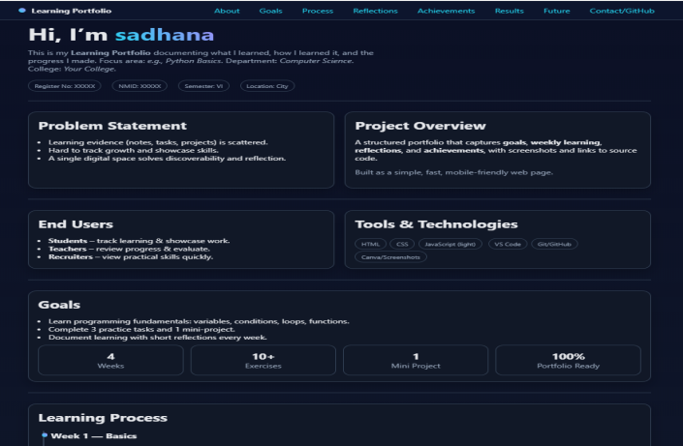
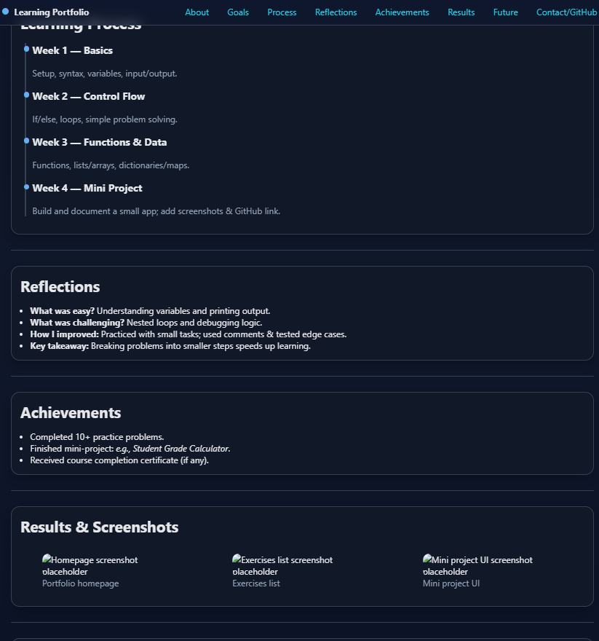

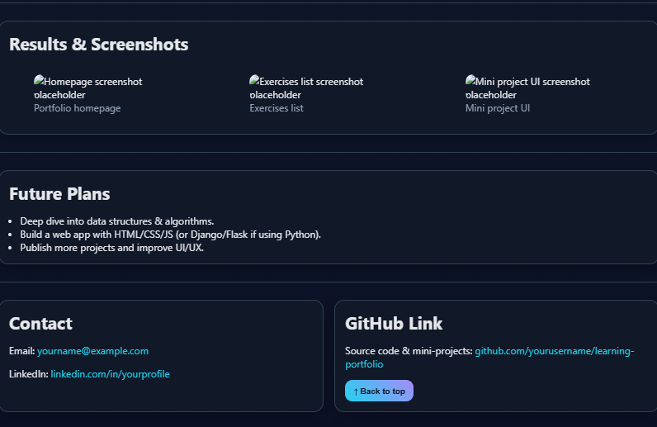
RESULTS AND SCREENSHOTS
3/21/2024 Annual Review
10

Slide 11
CONCLUSION
A learning portfolio helps in self-assessment and presentation of skills.
It is useful for academic growth, placements, and personal branding.
Future improvements: add interactivity, more projects, and multimedia.
11

